Slide 1
AZURE VPN – Virtual Private Network
Join an outside machine or network to Azure Network
End-to-End encryption of traffic
Able to access systems by their Private Ips
Types:
1.Point to Site (P2S)
2.Site to Site (S2S)
Express Route

Slide 2
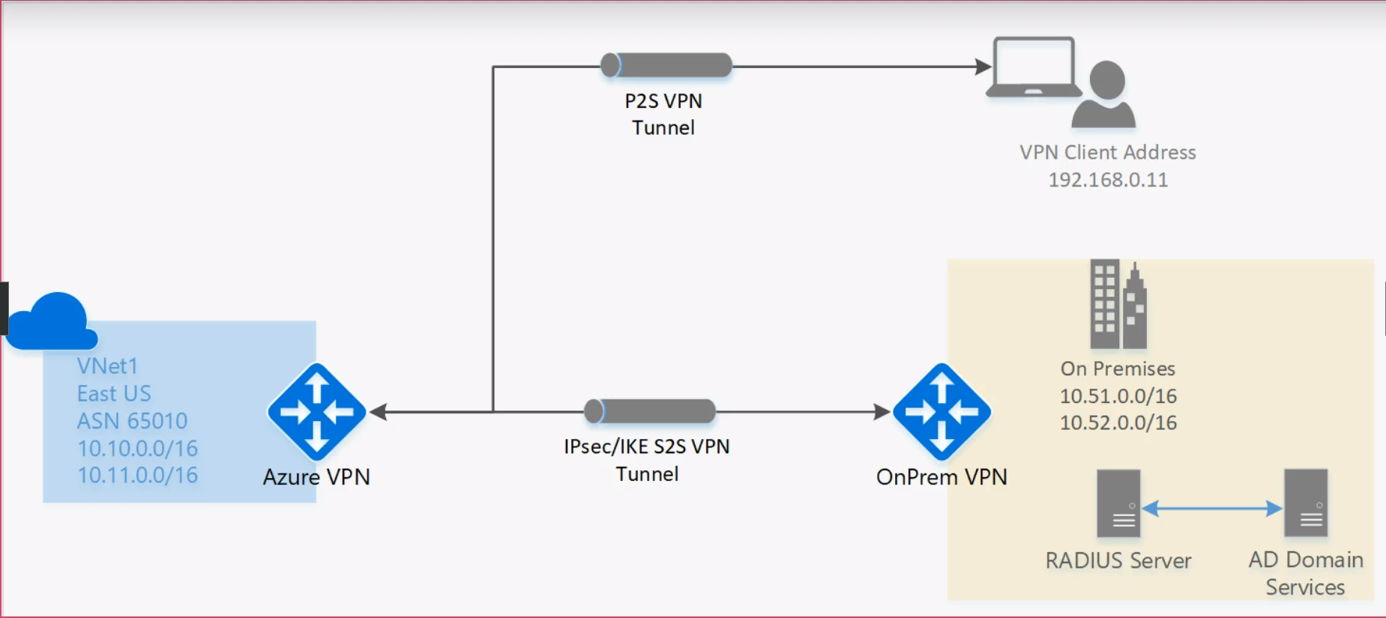
P2S & S2S :

Slide 3
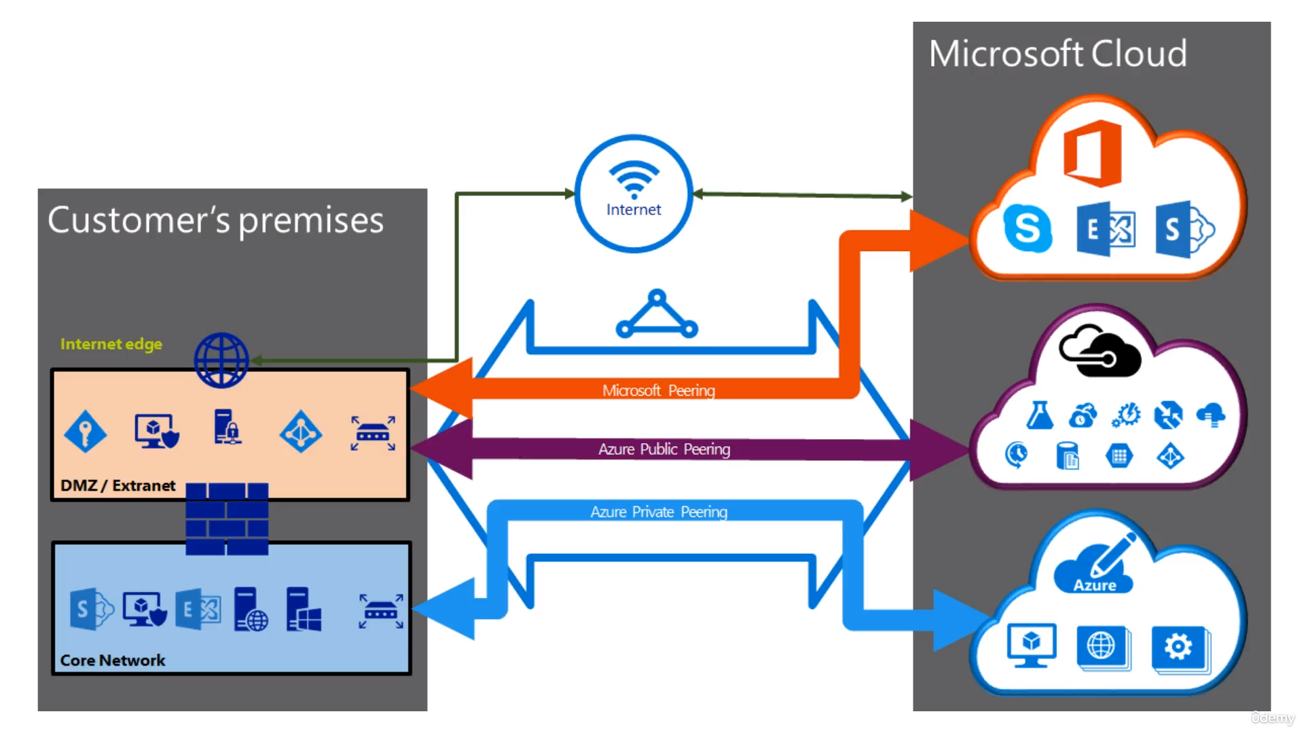
Express Route

Slide 4
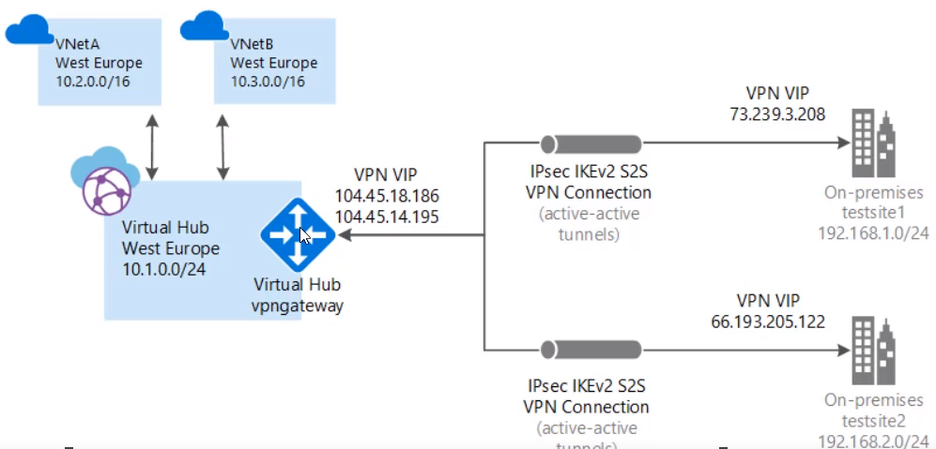
WAN

Slide 5
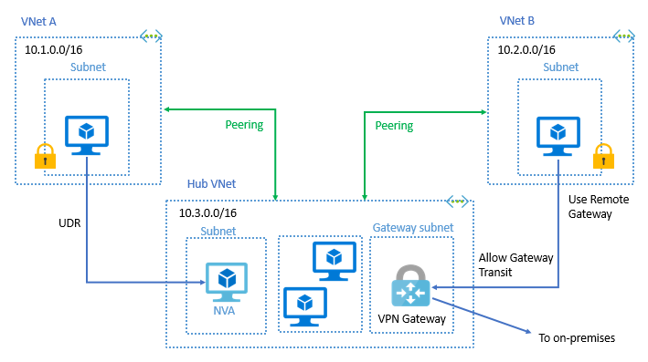
Virtual network peering: Connecting virtual networks within the same Azure region.
Global virtual network peering: Connecting virtual networks across Azure regions.

